Slide 1
Willow Bank Infant School
Foundation Stage
Information Evening
Thursday 11th November 2021
7pm

Slide 2
Aims of tonight
To provide information about the Early Years Curriculum.
To understand how we teach early reading and maths.
To gain ideas of how you can help your child at home.

Slide 3
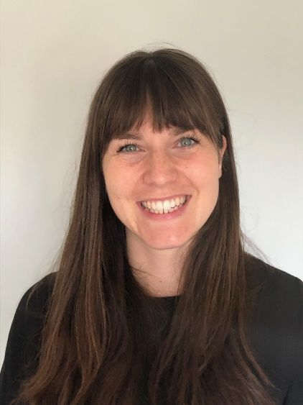
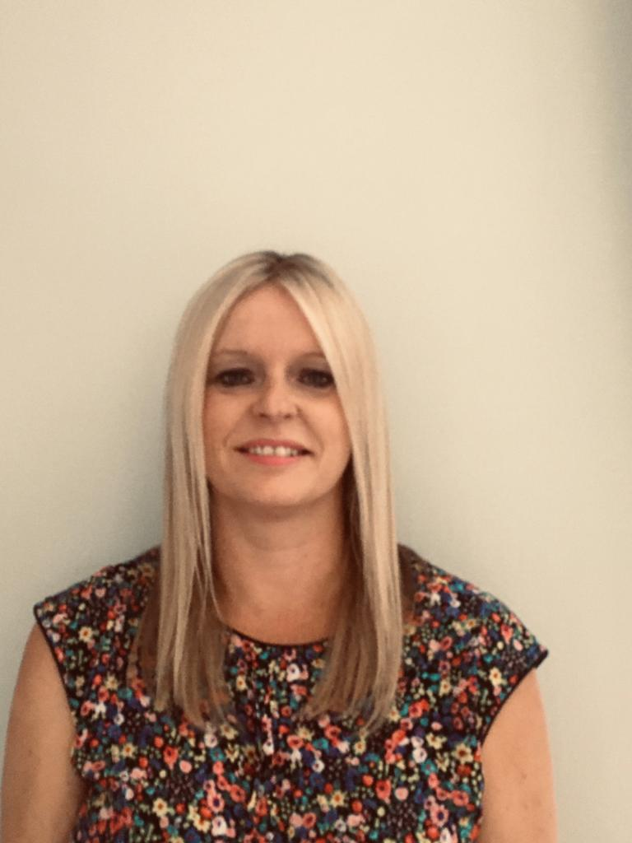
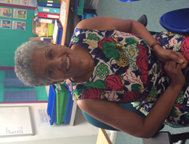
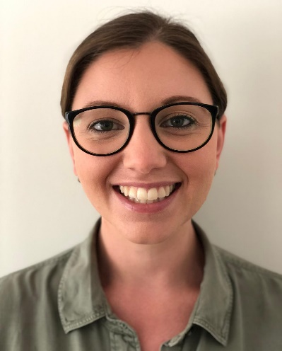
Who is who?
Badgers Class
Mrs Lamb and Mrs Bergmann
Rabbits Class
Mrs Ogbeide
Mrs Merritt – Covid catch up ( 3 Days)

Slide 4
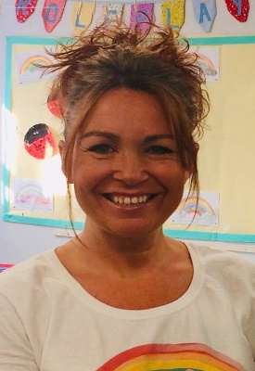
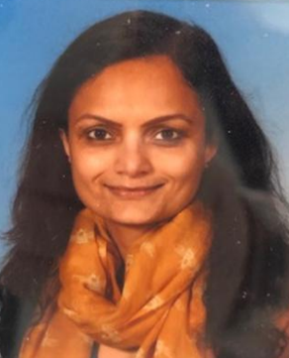
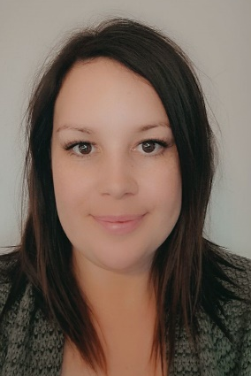
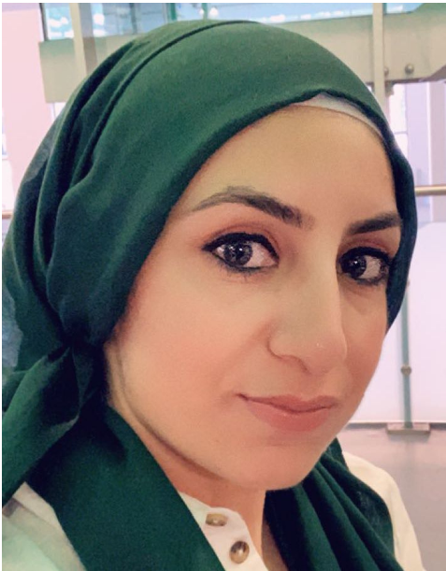
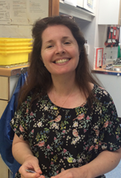
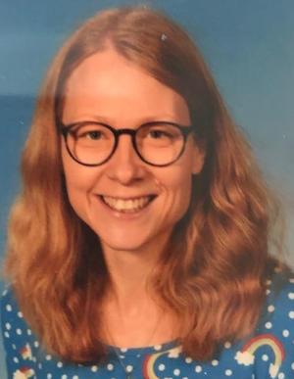
Teaching Assistants:
Mrs Fuller and Mrs Patel – (job share)
Miss Cosham and Mrs Mian (job share)
Mrs Wilson and Mrs Morris (job share)

Slide 5
A Typical Day
Register and songs
Fruit in the morning and milk in the afternoon
Daily Phonics
Whole class teaching and small guided groups
Play and learn – free exploration of the challenges and environment both inside and outside

Slide 6
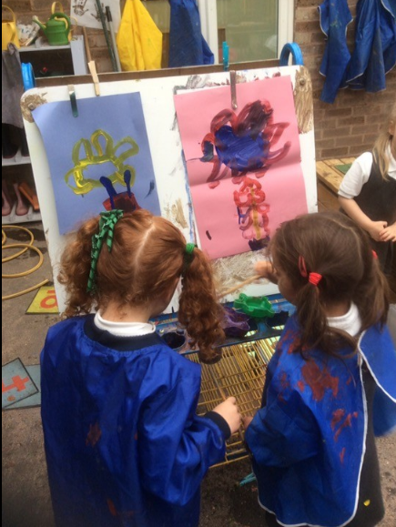
What is the Foundation stage curriculum?
Reception is the beginning of your child’s school journey and lays the foundations for a lifelong love of learning.
Ensuring that our children feel happy and enjoy school is our biggest priority.
We foster these positive attitudes towards school and learning through:
    Supportive interactions with adults (Both teachers and TAs)
    Creating a stimulating learning environment
    Planning an inclusive curriculum which not only explores exciting topics but is also flexible to follow the interests of the children.
    Getting to know your child and seeing them for the unique individuals that they are!

Slide 7
Our Curriculum
Topic based
Our curriculum not only helps your children to develop academically but also physically, verbally, cognitively and emotionally.
Autumn 1 | Autumn 2 | Spring 1 | Spring 2 | Summer 1 | Summer 2
All about me/ Bears | Celebrations | Around the world | People who help us | Traditional tales | We’re all going on a Summer holiday

Slide 8
Characteristics of effective learning
Playing and Exploring
Children investigate and experience things, and ‘have a go’
These are the behaviors that children use in order to learn.
Active learning
Children concentrate and keep on trying if they encounter difficulties, and enjoy achievements
Creating and thinking critically
Children have and develop their own ideas, make links between ideas, and develop strategies for doing things
We want our children to be curious, enthusiastic and independent learners.
We want their learning to be meaningful so that they are able to use what they have learned and apply it in new situations.

Slide 9
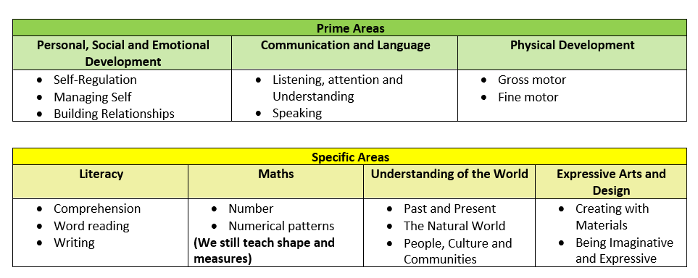
The EYFS Curriculum consists of the seven ‘Areas of Learning and Development’
ELG – End of Year Assessment
Tracked throughout Year

Slide 10


Gem Power
We focus on 2 gems in Foundation Stage:
      Diamond – problem solving and being independent.
Ruby – being kind, helpful and supportive
The children are awarded a gem for the class if an adult sees them demonstrating these learning behaviours.

Slide 11
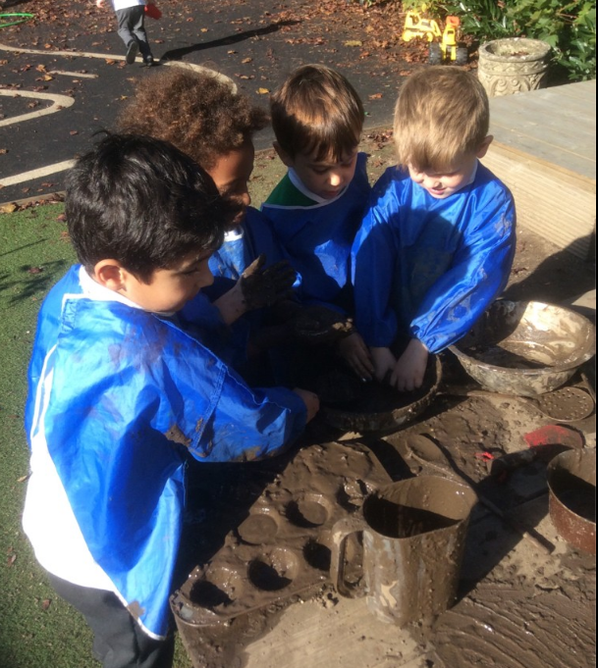
Continuous Provision
Continuous provision describes all of the different provision areas which are available for your children to use every day.
During ‘Play and learn’ time, your child is free to explore the challenges and learning environment both inside and outside.

Slide 12
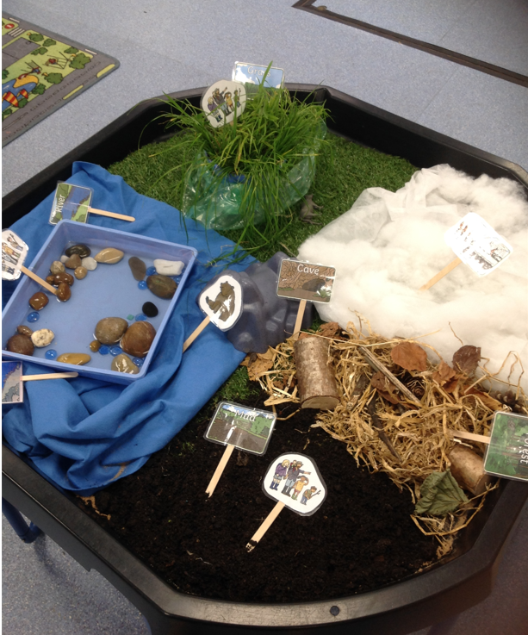
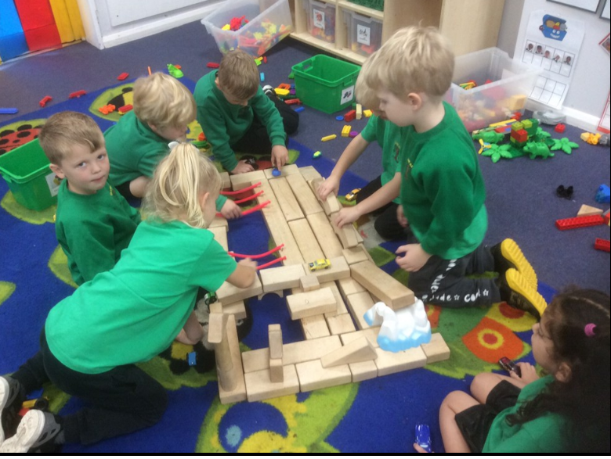
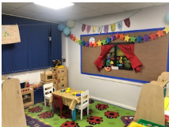
Walking around the Foundation Stage you will see…
Construction area
Investigation area
Role play area

Slide 13
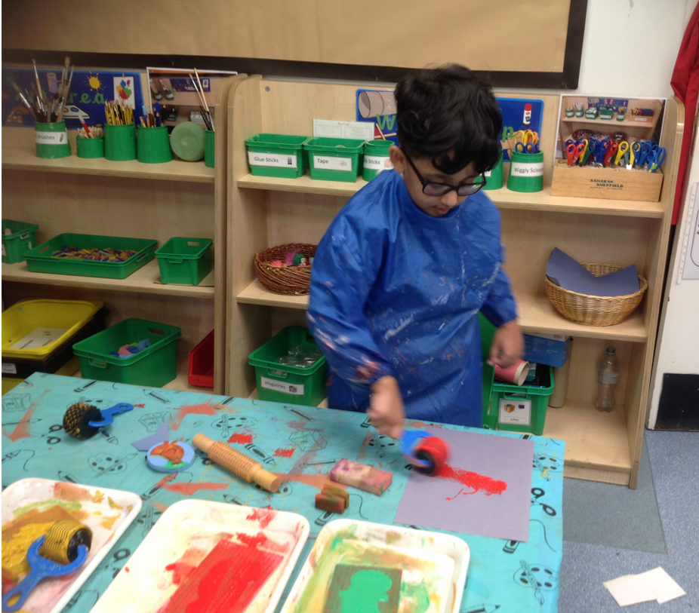
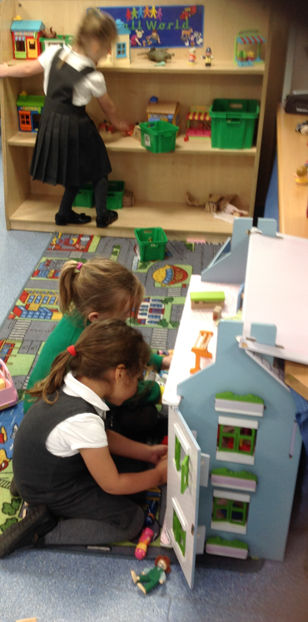
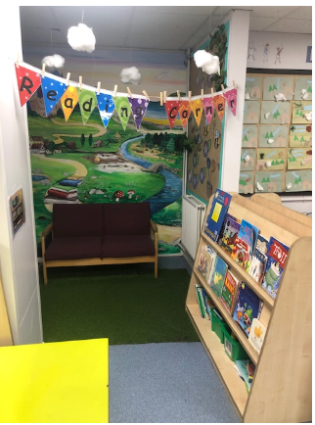
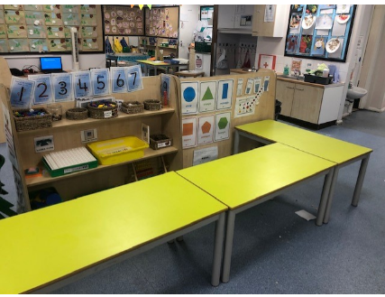
Creative area
Reading Corner
Small World
Maths area

Slide 14
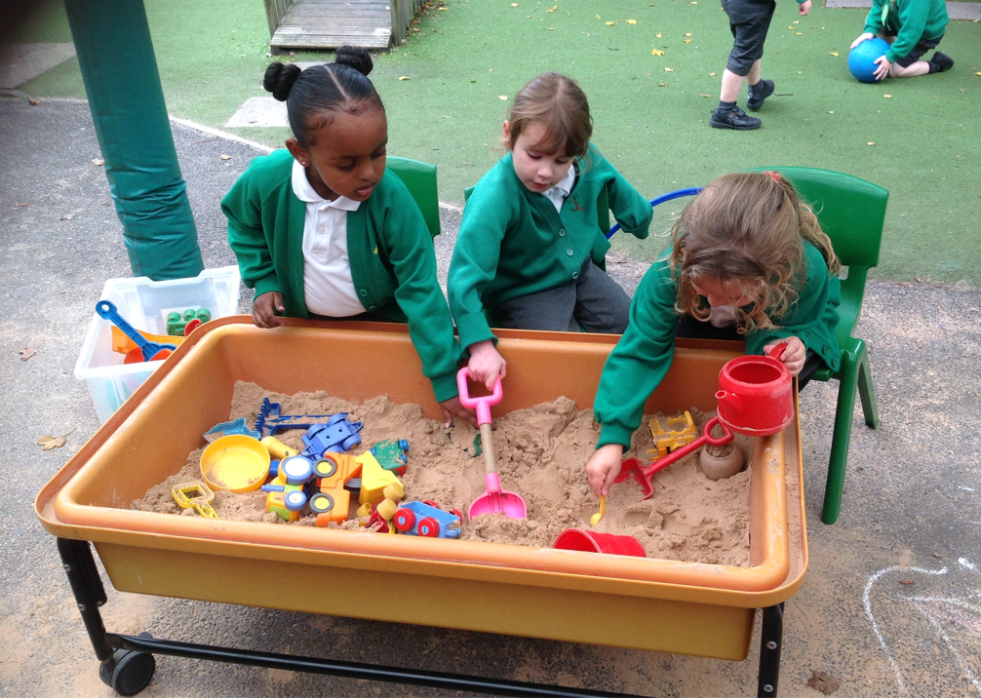
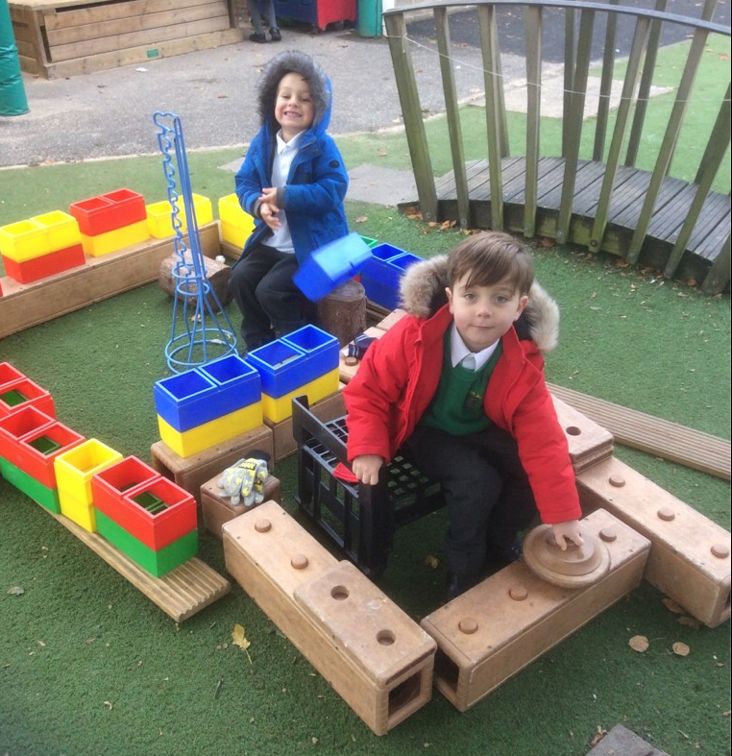
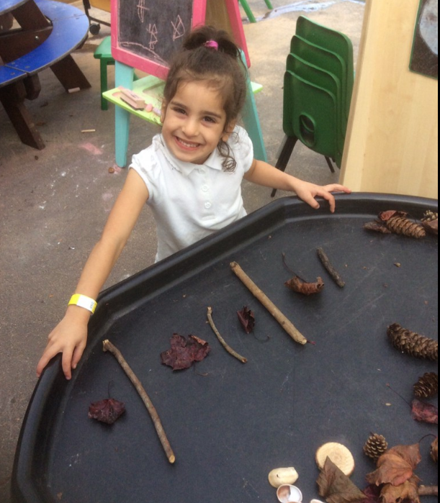
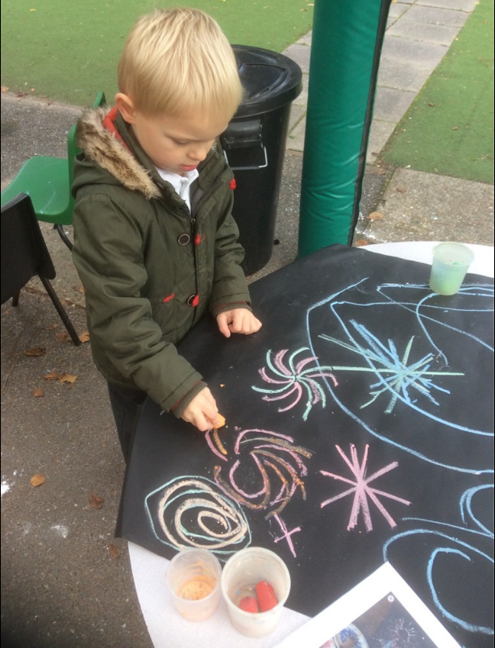
These opportunities are also in the outdoor area

Slide 15
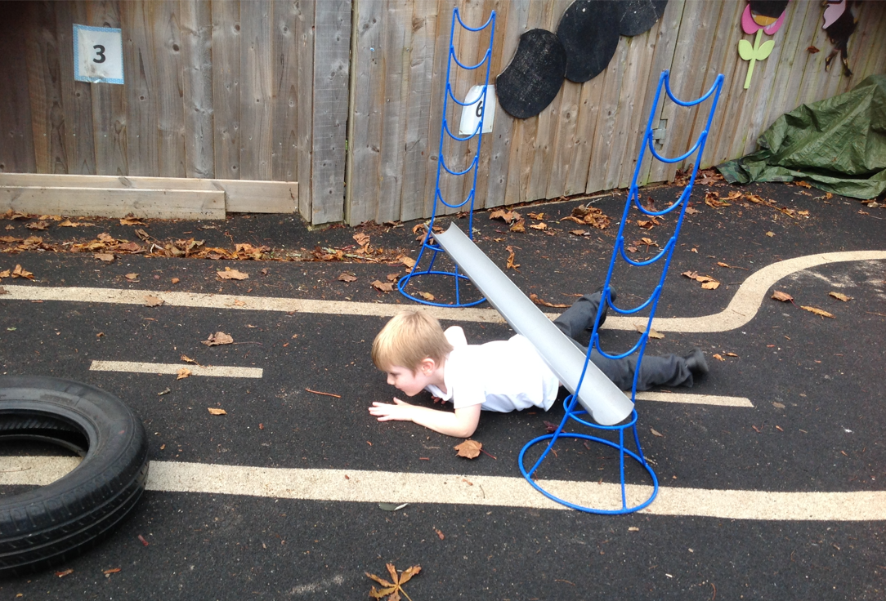
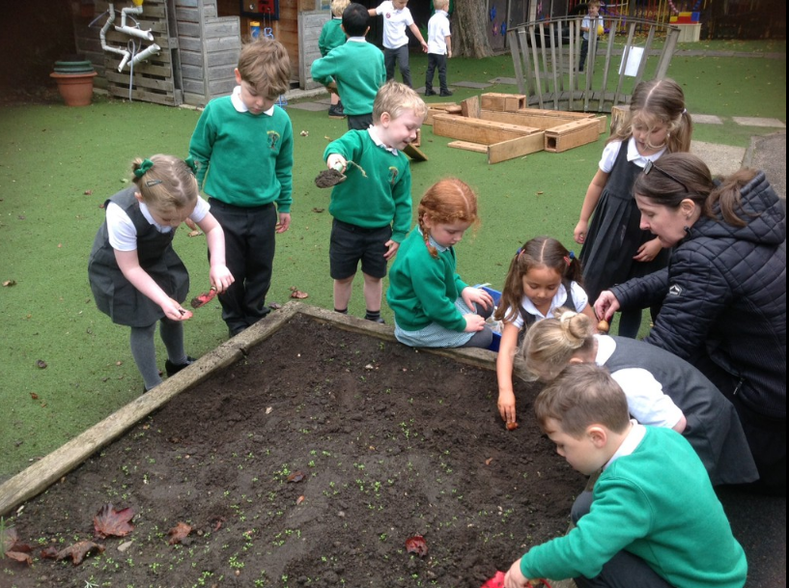
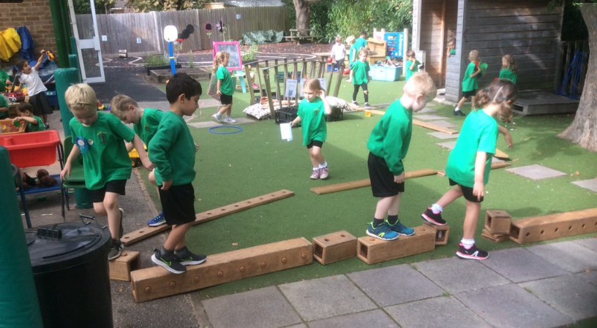
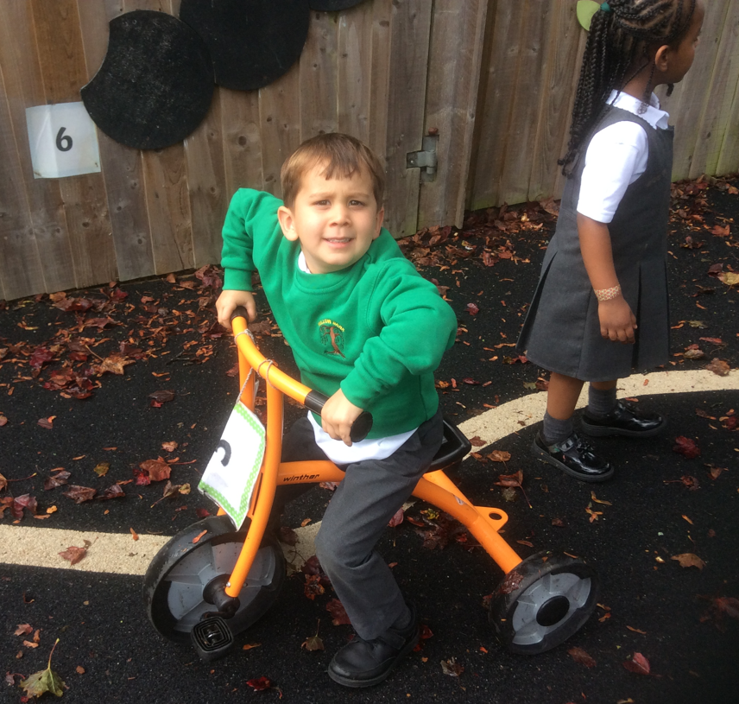
With additional opportunities for gross motor and physical development

Slide 16
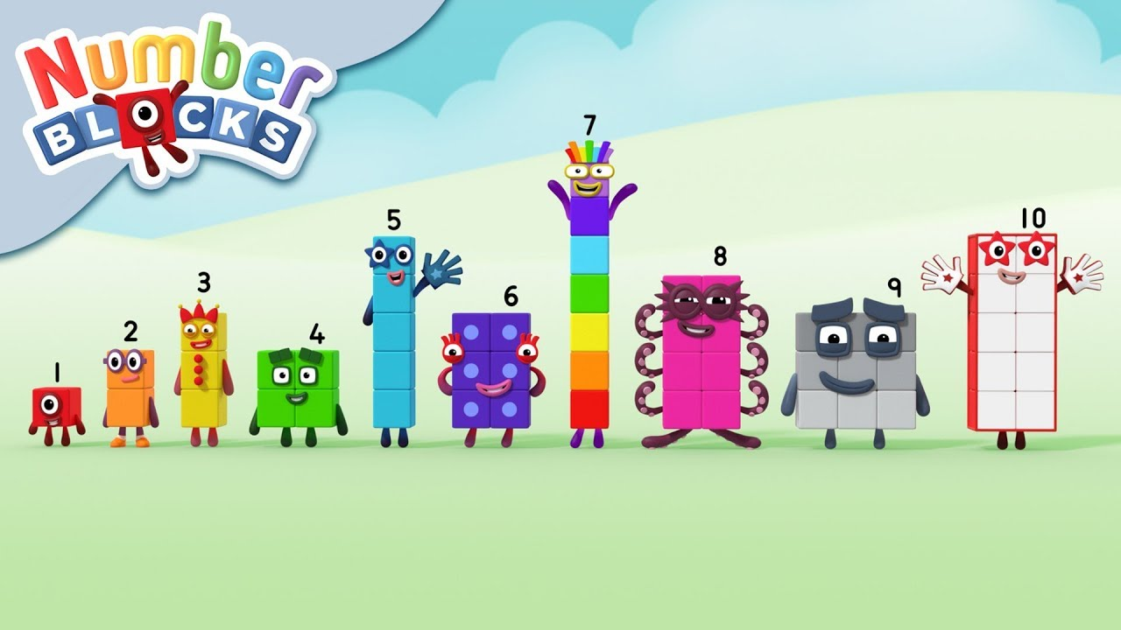
Teaching Maths in EYFS
A Mastery Approach

Slide 17
What is Teaching for Mastery?
We see Teaching for Mastery in maths as allowing the pupils to gain a deep understanding of maths, allowing them to have a secure and long-term understanding of maths in a way that is age appropriate and engaging.
We believe that everyone can do maths. Teaching for mastery means we teach by breaking down maths objectives into the smallest steps, so that every pupil is secure in every new concept before moving on. We focus upon teaching for fluency, reasoning and problem solving.
A large majority of mathematical work is practical and learning will happen in many different contexts around the classroom and outside.

Slide 18
Throughout your child's year in FS they will learn:
There are six key areas of early mathematics learning, which collectively provide a platform for everything children will encounter as they progress through their maths learning at primary school, and beyond.
ML

Slide 19
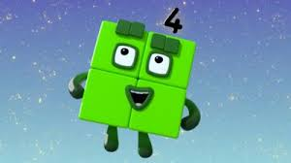
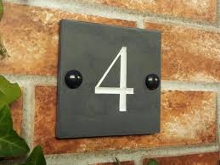

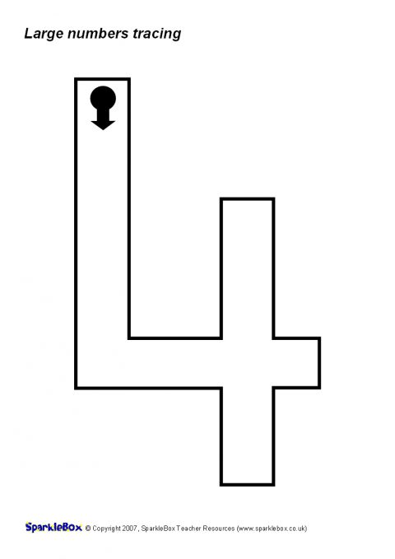
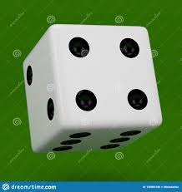
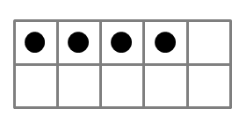


How do we teach for Mastery in Early Years? In Reception we are teaching the children early number sense . This is critical as it allows them to develop a deep understanding of number that they will need in the future.
Representing Numbers
We want to develop children’s number sense so that they understand the number rather than just recognising the numeral. Lots of our children can already count to beyond ten but developing good number sense is about knowing each number in depth.
Children need to understand that numbers can be represented in many ways, not just as a written numeral. We use many different objects and pictures to show that numbers can be represented in lots of ways.
Children sometimes need lots of practise to recognise numbers in different forms. We play games that encourages children to recognise and make different amounts in our indoor and outdoor areas.

Slide 20
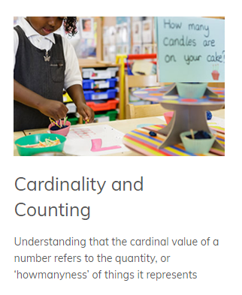
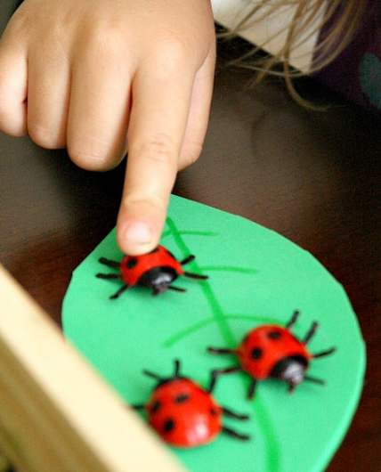
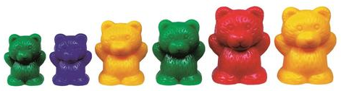
Counting- In reception we start to explore the fundamental counting principles.
1. Stable order- say the number names in the correct order and knowing that the order will not change. 1,2,3,4,5 not 1,4,3,4,9,11. Counting rhymes and songs really help with this.
2. The one to one principle refers to the need count to touch count objects once and only once. This is often something that children need a lot of help with. Lining up objects helps with this.
3. Cardinal principle- Counting out from a larger set to encourage children to know the last number we say is how many in the set. Often children will need to re count the set again.
4. Order irrelevance-That we can count objects in any order and the total stays the same. Even if we rearrange the objects they will still stay the same. Children need opportunities to count objects left to right and top to bottom.

Slide 21
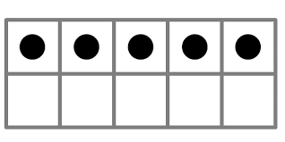

Understanding that the total stays the same even when the objects move
When children first start to use numbers, they often do not understand that if we move objects into another arrangement the total stays the same. We practice this with many different types of objects but a useful tool is using a tens frame to be able to move counters around and put one object in each box.
•
•

Slide 22



Subitising..
.Is a vital and essential skill to securing number sense and is key to future success with addition and subtraction, multiplication and division.
Subitising is developing a recognition of a number of objects without needing to count them.
We start by looking at patterns of 3 using fingers, dot patterns and small objects. We then move on to patterns involving 4.
What do you see? How do you see it?
Children need opportunities to see regular arrangements of small quantities. Subitising can help children to build images for numbers, to visualise and to learn number facts.
.
ML

Slide 23
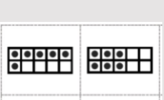

Subitising – Don’t count see the amount!
Beyond five, other mental strategies come into play for identifying the number of items in a group without counting them individually.
What can you see? How do you see it?
Subitising is building the foundations for early pattern seeking as well as early addition and subtraction skills, multiplication/division.

Slide 24
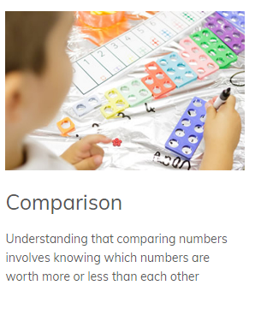
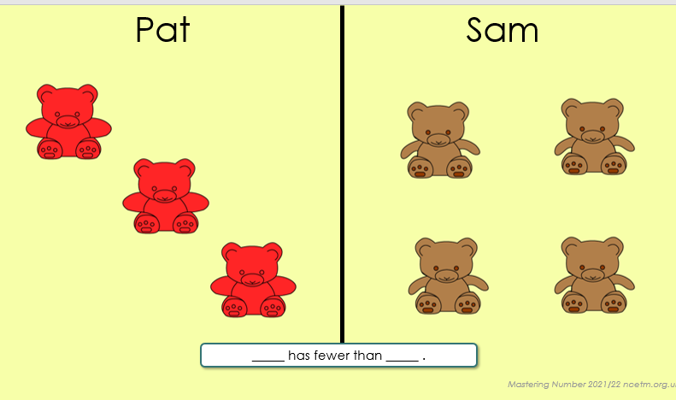
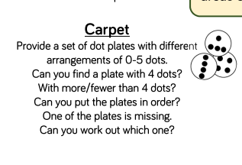
Comparison
Pat has more than Sam. Sam has fewer than Pat.

Slide 25
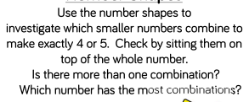
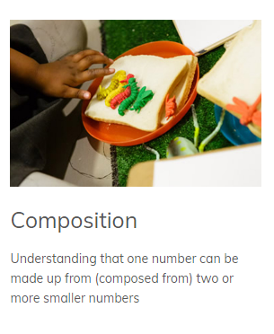

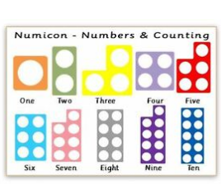
Composition
All numbers are made up of smaller numbers . We allow the children to explore and notice the different composition of numbers. We look at each number in depth, up to 10 initially.

Slide 26
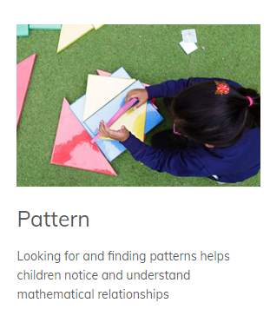
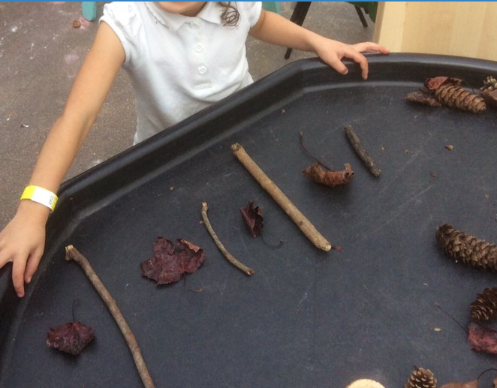
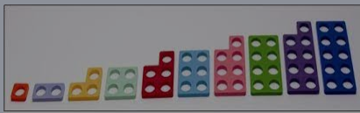
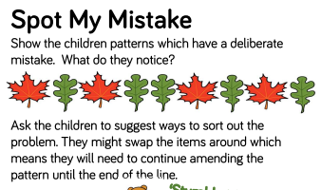
Pattern
We start with continuing and copying AB patterns. Children then make their own patterns.
Spotting errors- children are good at this! They need the language to describe the errors
This is the pre requisite skill to pattern seeking with numbers. Notice the 1 more/less step pattern here.

Slide 27
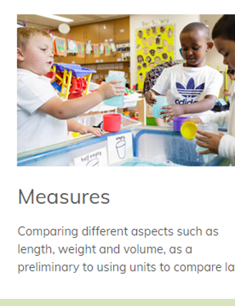
Measures – capacity, weight, shapes.
We encourage children to make direct comparisons when weighing, measuring and finding out how much something holds, using the key language. This is taught mostly through play experiences.
We provide opportunities such as water and sand, rice.
Problem solving is encouraged.
Which container holds the most? How many cups of rice will it take to fill the container?
Key language of measurement- empty, full, more , less, long, short, longer, shorter, heavy, light, heavier than.. lighter than , the same as, is equal to, tall, thin, narrow , wide, shallow.

Slide 28





Be aware of shapes in their environment
2D
3D
Language-
Circle, square, rectangle, triangle, star.
Sides, corners, flat, round
What is the same/different?
Language-
Sphere, pyramid, cylinder, cube, cuboid, cone.
Edges, faces, vertices, solid

Slide 29
Whole Class Teaching
A typical lesson consists of daily counting, recognition of numbers, subitising, comparing and composition of numbers or shape or measure.
Children are encouraged to answer in full sentences using the precise vocabulary. ‘ I know it is 5 because I can see 2 red cars and three yellow cars.’ ‘four is made of three and one’ ‘four take away one leaves three’
Reasoning skills are encouraged to deepen the children’s understanding . How did you do that? Why is the answer not correct? Who did it in a different way? Children are asked to share their thinking with a partner.
Focused small group work happens after a whole class input. Group work is tailored to the needs of the children.
Children can freely explore these concepts through a variety of different activities /challenges and resources set up each day.
ML

Slide 30
Reasoning
Reasoning in maths helps children to be able to explain their thinking, therefore making it easier for them to understand what is happening in the maths they are doing. It helps them to think about how to solve a problem, explain how they solved it and to think about what they could do differently. In Reception, some examples of reasoning are:
• True and false statements e.g. adding one to a number always makes it smaller
• Spotting incorrect maths e.g. 1, 2, 3, 4, 6, 5, 7, 8, 9, 10
• Explaining how we know something or how we worked it out .
Spotting the odd one out and giving a full explanation.

Slide 31


Maths through play

Slide 32




Making the most of routines
ML

Slide 33


Reading
Reading is making meaning from print.
In order to be an able reader a child has to have strong language comprehension and good decoding skills.
Children develop their decoding skills during phonics instruction.

Slide 34
What is phonics?
Sounds
Graphemes
All words are made up of individual sounds. These sounds are merged together to form words.
e.g. in ‘mat’ we have the sounds ‘m’, ‘a’, ‘t’, ship – ‘sh’, ‘i’, ‘p’.
A grapheme is another name for the letters we use to write the sound. The spelling of that sound on the page.
Phonics is the method of teaching reading through the identification of sounds and graphemes.
This gives your children the tools to read any word.

Slide 35
English alphabetic code
We use 44 sounds to make all the words in the English language.
This means we’ve got a problem.
We’ve got 44 sounds and only 26 letters.
The 26 letters work singly, in pairs and sometimes in threes to represent one sound.
We have to group letters together to write some sounds e.g. ‘igh’, ‘air’.
In English we have more than 150 ways to represent 44 sounds, using the 26 letters in the alphabet.
Click
This makes our language one of the most complex in the world!

Slide 36

Speed Sounds Set 1 and Set 2
Here is a simple speed sound chart which shows the children are to know by the end of Reception. Children need to know the sounds and not letter names to read words. We teach the children to pronounce the sounds using the pure sounds, so that they are able to blend the sounds together to make reading words more easily.

Slide 37

Sound + Blending = Reading
s
a
t
+
Alongside teaching children sounds, we teach them to blend sounds to read words e.g. s-a-t, sat.
We use Fred Talk to help children read.

Slide 38

Fred
Let me introduce you to Fred.
Fred can only speak in sounds. He says d-o-g, h-a-t etc.
Speaking like Fred helps children to understand that words are made up of sounds.
Fred helps children practise blending sounds together because he needs the children to say the words for him. Fred says d-o-g, children tell him the word is dog.

Slide 39

Teach spelling using Fred Fingers
We use our fingers to count out how many sounds we can hear in a word.
We use Fred Fingers to help children sound out words to spell easily.
It means they do not have to memorise lists of spelling words.
It is a tool so they will be able to spell any word.

Slide 40








Reading Books
In your child’s book bag, they will bring home:
A wordless book
A picture book from the library.
Once your child is blending independently he/she will bring home a sound blending book, they would have read a similar book in their phonics lesson.
As they progress through the reading scheme they will bring home a Ditty sheet, followed by Book Bag Book and a decodable RWI reading book at the right level for them. Again they would have experienced reading a similar book in their phonics lesson.

Slide 41
Reading Books
The decodable RWI Story book
This is a book that they would have read in class. It is to practise reading what they can already read. The children enjoy re-reading stories they know well. Their fluency improves on every reading.
Book Bag Book.
These books are not RWI branded books. They are typically Oxford Reading tree books and have guidance on the inside page which is just for you as parents. They are matched your child’s reading level, so provide extra practice of the same sounds at the right level for your child.
A picture book from the library
This is to share with you at home You can read the story to them or they can retell the story by looking at the pictures. They are not expected to read the story themselves.
We make sure that every book that goes into your child’s book bag is a well-loved book – one they know already and want to read again and again.

Slide 42
The Power of Reading
Reading regularly is key to help children develop an interest in the
world around them.
It improves their listening skills, improves their vocabulary which leads to a more highly developed language skills.
It develops their imagination.

Slide 43


Handwriting
Children practise letter formation daily in phonics.
They use rhymes for letter formation taken from Read Write Inc Phonics Programme
Notes:
Children practise letter formation daily in phonics.
They use rhymes for letter formation taken from Read Write Inc Phonics Programme.

Slide 44

Talk for Writing
Talk for Writing helps children move from oral storytelling to beginning to write stories of their own.
Story Map – children use a story map and actions to learn and retell a story.

Slide 45
Ways to help your child at home
Be a good role model
Make reading and writing fun.
Share books with your child everyday.
Visit the library.
Provide writing opportunities e.g. shopping lists, letters, telephone messages.
Handwriting (play dough, threading, lacing).

Slide 46
Communication
Parents evening – we will discuss your child’s progress November and March
End of year report
Please do come and chat to us at the end of a day if you have any worries or concerns.
You can also get a message to us via the school office.
Information about what your child is learning is sent out in a weekly bulletin as well as ideas of how to help at home.

Slide 47
Important Dates: Important dates and events are included in our regular newsletters and can also be found on our school website.

Slide 48
Things to remember
Reading books
We will hear your child read weekly. Their reading book will be changed during this time if they have also read their book at home.
Please keep the reading record and reading books inside your child’s book bag. Please bring the book bag to school every day.
Library books
Please bring in library books into school on Thursday, so that your child can visit the library on Friday to select a different book.
Phonics
Please look out for Phonic reading activities in your child’s book bag. These will be sent out on a Friday.
PE Kit
Please send your child to school in P.E kit every Friday.

Slide 49
Thank You for Coming
We wish your child a happy and successful Foundation stage year.
?

