Slide 1
Parents’ Meeting
Introduction to Read Write Inc.
Notes:
Approximately 20 minutes is needed for this session.
Notes are provided to help you lead the presentation.
Notes in italics are for your attention only.
This bitesize parent session is designed as an introduction to Read Write Inc when you first implement the programme in your school and for parents of new YR children each September.
Use the other bitesize parent PPTs throughout the year to discuss and practise how they can help their child at home based on the child’s group.
Notes are provided to help you lead the presentation.
Notes in italics are for your attention only.
Provide copies of ‘Reading at Home Booklet 1 or 2’ from Oxford Owl.
Booklet 1 is sound groups and Ditty/ Red Groups and Booklet 2 for Green – Grey Storybooks.

Slide 2

Welcome!

Slide 3
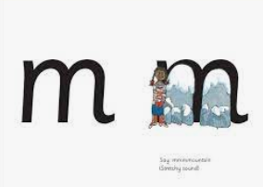
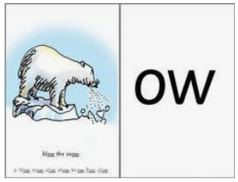
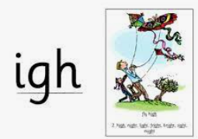
What is phonics?
Sounds
Graphemes
Phoneme- Single sound
Digraph – 2 letters, one sound
Trigraph – 3 letters, one sound
Special friends – phonemes
represented by more than one letter
Notes:
All words are made up of individual sounds. These sounds are merged together to form words.
e.g. in ‘mat’ we have the sounds ‘m’, ‘a’, ‘t’, ship – ‘sh’, ‘i’, ‘p’.
Click A grapheme is another name for the letters we use to write the sound. The spelling of that sound on the page.
Phonics is the method of teaching reading through the identification of sounds and graphemes.
The new National Curriculum ensures that all children are taught Phonics systematically.
This gives your children the tools to read any word.

Slide 4
English alphabetic code
44 sounds
26 letters
Over 150+ graphemes (letter combinations)
One of the most complex alphabetic codes in the world.
Notes:
We use 44 sounds to make all the words in the English language.
This means we’ve got a problem.
We’ve got 44 sounds and only 26 letters.
The 26 letters work singly, in pairs and sometimes in threes to represent one sound.
We have to group letters together to write some sounds e.g. ‘igh’, ‘air’.
In English we have more than 150 ways to represent 44 sounds, using the 26 letters in the alphabet.
Click
This makes our language one of the most complex in the world!

Slide 5
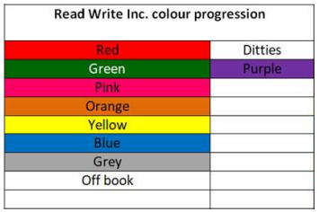
Read Write Inc. Phonics
Children learning to read in YR– Y2
We aim for most of our Year 2 children to complete the RWI program by the end of the spring term. However, some will continue to join phonics groups throughout year 2.
Your child is assessed every 6 weeks and joins a colour group to match their ability.
Notes:
Who Is Read Write Inc Phonics for?
(Click) Phonics is for children in Reception, Y1 and Y2 who are learning to read.
Phonics is also for children in Y3 and Y4 who haven’t met the KS1 reading expectations. They need to catch up.
(Click) Fresh Start is for children in Y5 and Y6 who are still learning to read.
Fresh Start is structured in the same way as the Phonics programme, but uses age-appropriate texts.
Each half-term, we assess and group our children based on their stage of reading not age of reading. This means all children practise reading at the right level.
Explain how you group across YR/ across KS1, across Y3/4 as applicable to your school.

Slide 6
Speed Sounds Set 1 and Set 2
Notes:
Using RWI, we make learning to read easy for children because we start by teaching them just one way of reading and writing every sound. Here they are on the Simple Speed Sounds chart we use in class.
We teach Set 1 sounds first - (sounds as far as a e i o u).
Children need to know sounds – not letter names – to read words.

Slide 7
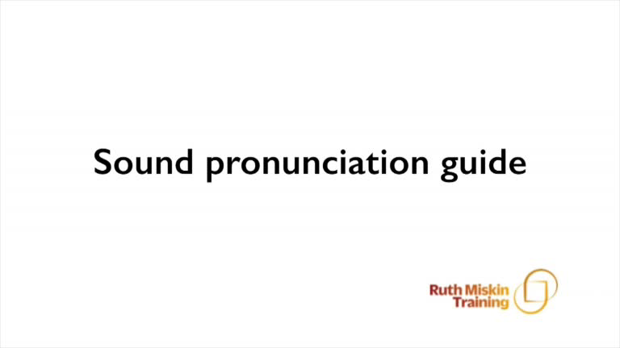
Pure Sounds (ruthmiskin.com)
Notes:
We teach using pure sounds.
We pronounce the sounds clearly, using pure sounds (‘m’ not’ muh’, ’s’ not ‘suh’, etc.) so that your child will be able to blend the sounds together to make words more easily.
You can watch this film of little Sylvie on the Ruth Miskin website to practise using pure sounds. Play a little bit of the video.

Slide 8
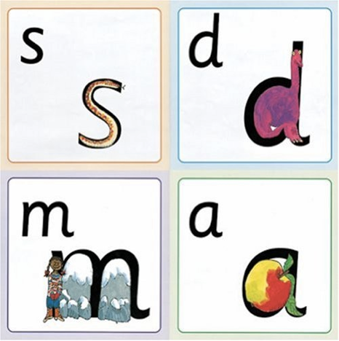
Name the pictures
Notes:
We give children a hook to learn the sounds by using pictures in the same shape as the letter.
‘s’ looks like a snake.
‘d’ looks like a dinosaur.
‘m’ looks like a mountain.
‘a’ looks like an apple.
We teach the children to name the mnemonic pictures before they learn the sound.
This means that children learn to read and write the sounds really easily.

Slide 9
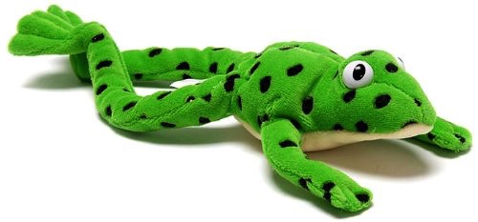
Fred
Notes:
Let me introduce you to Fred.
Fred can only speak in sounds. He says d-o-g, h-a-t etc.
Speaking like Fred helps children to understand that words are made up of sounds.
Fred helps children practise blending sounds together because he needs the children to say the words for him. Fred says d-o-g, children tell him the word is dog.
This is how we quickly teach all of our children to blend.

Slide 10
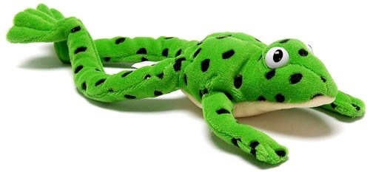
Fred Talk routine
Say the word in sounds as Fred e.g. c-a-t.
Ask your child to repeat. Can they ‘jump-in’ with the whole word?
Say the word in sounds followed by the whole word e.g. c-a-t, cat
Ask your child to repeat
Notes:
Fred Talk follows a consistent routine:
Say the word in sounds as Fred e.g. c-a-t. Ask children to repeat. Pause to allow children to ‘jump-in’ with the whole word.
Say the word in sounds followed by the whole word e.g. c-a-t, cat. Ask children to repeat.

Slide 11
Fred games and Fred talk throughout the day
l
-u
?
Shall we have some
What would you like to
Let’s put on your
-ch
-n
-ay
-l
p
?
-oa
-t
c
.
Notes:
Try to use Fred Talk throughout the day at home to help your child practise blending sounds together.
Fred Talk words at the end of the sentence and keep the words short and simple.
With the person next to you, have a practise of the three sentences on the screen.
Remember to Fred Talk the last word of the sentence.
You can also play Fred Games with your child at home. I will show you one of these in action in a moment,

Slide 12




Reading with Fred Talk
Notes:
We teach children to read words using Fred Talk to blend together the sounds they know e.g. m-a-t, mat.
We say ‘Fred Talk, read the word’.
Model by asking other teachers to read green word “mat”
Marian to place the sound cards in the wallet and teach me to read using the sounds and then the green word card.

Slide 13
Speed Sounds Set 3
CA
Notes:
Once children know how to read Set 2 sounds, they start to learn Set 3 sounds.
These are shaded in the chart.
They are alternative graphemes (spelling of a sound) for the Set 1 and Set 2 sounds the children already know.
Point to the chart to show. For example, they know ‘ay’ and now learn a-e and ai as other spellings for the same sound.

Slide 14
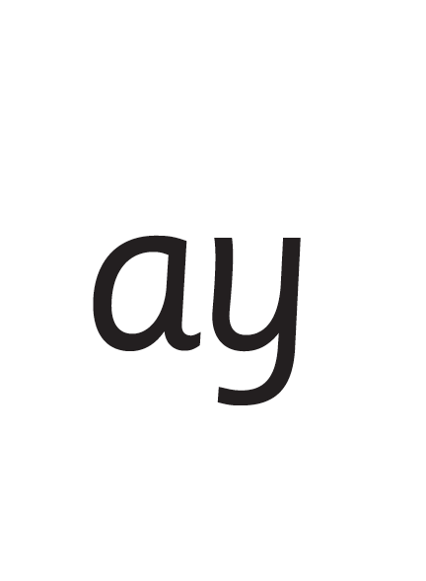
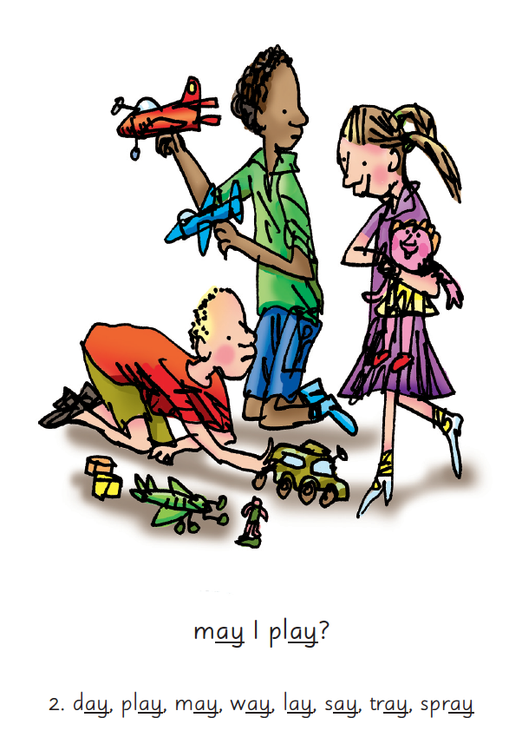
Picture Phrases
Notes:
We use picture phrases to help children remember the Set 2 and Set 3 sounds.
For example, ay, may I play? aw, yawn at dawn
Someone to hold up cards and show both sides.

Slide 15

‘Special Friends’, ‘Fred Talk’, read the word
+ Multisylabic - playground
Notes:
Then children practise reading these sounds in words using the routine ‘Special Friends’, ‘Fred Talk’, read the word’.
They spot the ‘Special Friends’ first, then Fred Talk to read the word.
For example, ‘ay’, s-p-r-ay, spray.
Model reading by other teachers.

Slide 16

Teach spelling using Fred Fingers
Notes:
We use Fred Fingers to help children sound out words to spell easily.
It means they do not have to memorise lists of spelling words.
It is a tool so they will be able to spell any word.
Model by asking teachers to spell green word “mat”

Slide 17
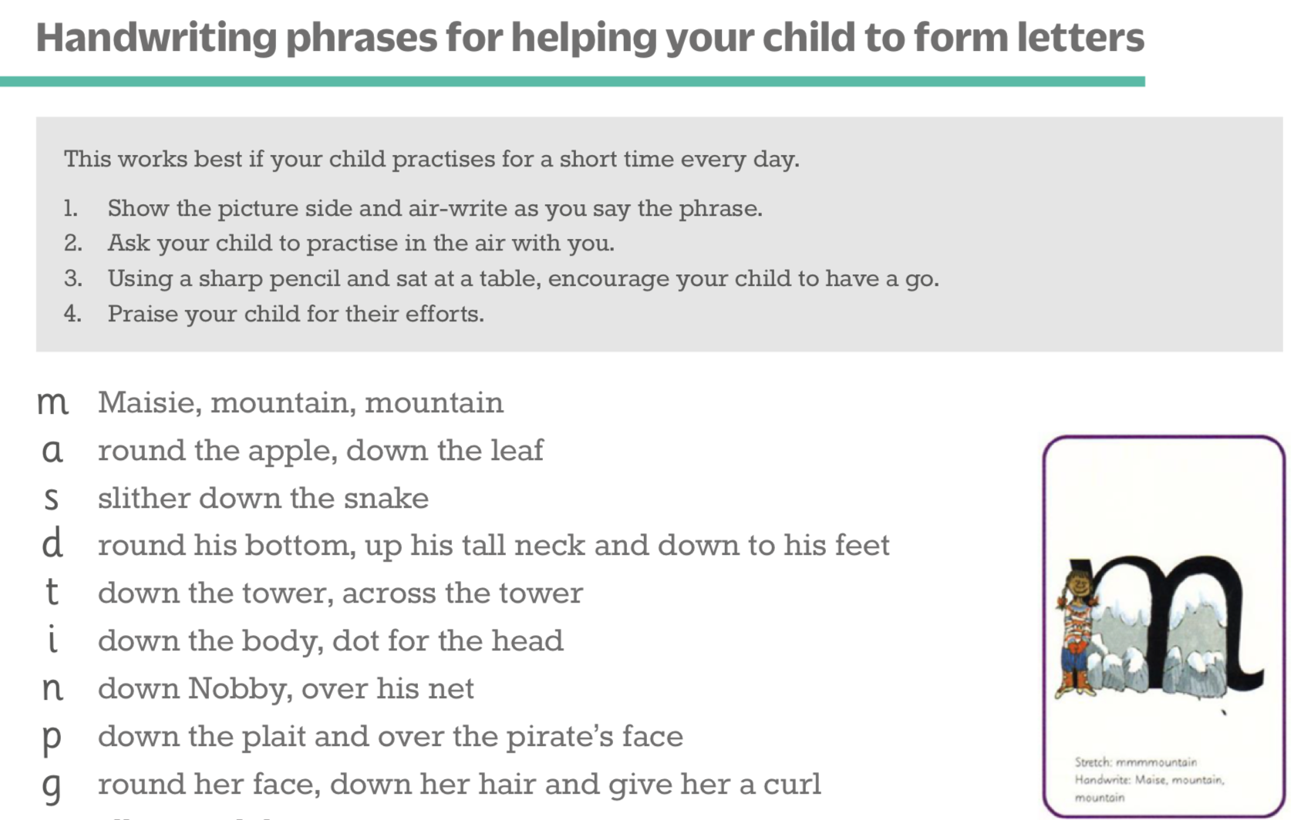
Teaching letter formation
Notes:
Children use the picture mnemonic to learn to form letters correctly at the same time they learn to read each sound.
Each sound has a handwriting phrase e.g. down Maisie, and over the mountains.
Use these handwriting phrases when practising writing at home with your child.
Avoid using these to read the sound.
I will give you a handout of these handwriting phrases when you leave today. This is the proscribed order.

Slide 18


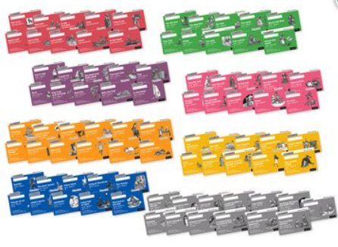
What will your child bring home?
Notes:
In your child’s book bag, they will bring home:
the Storybook they have read in class to practise reading what they can already read.
if applicable a ‘Last and past’ Storybook – a previously read RWI Storybooks for extra practice. The children enjoy re-reading stories they know well. Their fluency improves on every reading.
- if applicable a Book Bag Book.They have guidance inside just for you as parents., They are matched to the books children read in school so provide practice of the same sounds – extra practice at the right level for your child. They include many of the same reading activities that we use in class.
A picture book to share with you which has already been read to them so they care about it. You can read the story to them or they can retell the story by looking at the pictures. They are not expected to read the story themselves.
We make sure that every book that goes into your child’s book bag is a well-loved book – one they know already and want to read again and again.

Slide 19
Online resources available
Ruth Miskin Parents’ Page:
http://www.ruthmiskin.com/en/parents/
Ruth Miskin Facebook:
https://www.facebook.com/miskin.education
Free e-books for home reading:
http://www.oxfordowl.co.uk/Reading/

Slide 20
Any questions?
Q&A

Slide 21
Split into year groups
Foundation talk– Watch a set 1 phonics lesson in action then “How to read with your child” workshop. with Mrs Ogbeide and Mrs Tate
Year 1 talk – Watch a set 2 phonics lesson in action then “How to read with your child and support your child with the Phonics screening” workshop With Mrs Leviss, Mrs Grimes, Mrs Patel
Year 2 talk – Watch a set 3 phonics lesson in action then a talk on “What happens when my child has completed RWI” talk.
Mrs Atkinson

Slide 22
Foundation talk
We are going to show you a RWI video that will show you how your child is taught to blend.
We will then show you how to read with your child using the books they will bring home throughout the year.

Slide 23
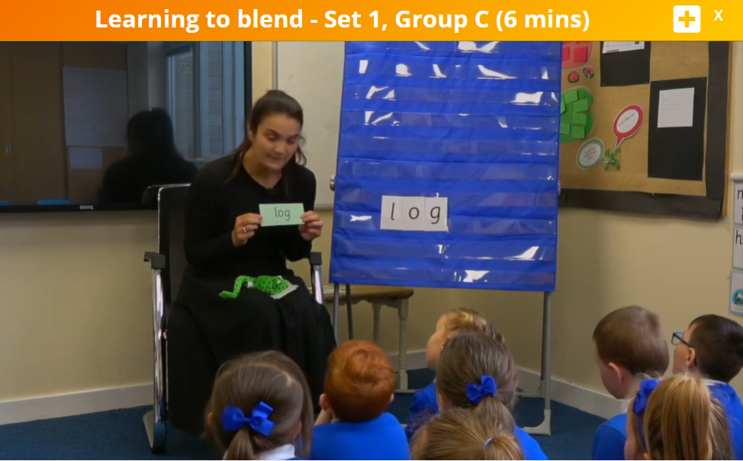
Set 1 video to watch

Slide 24
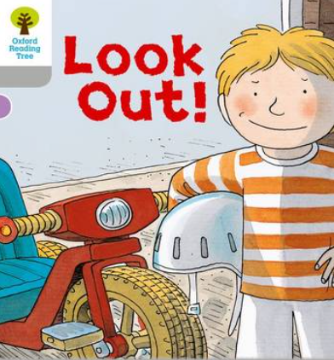
Wordless books – lime green

Slide 25
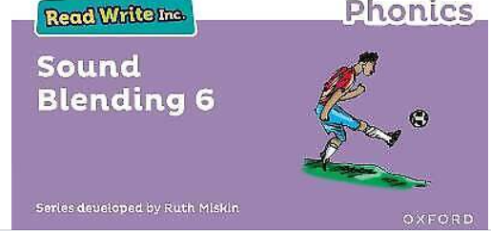
Sound blending books

Slide 26
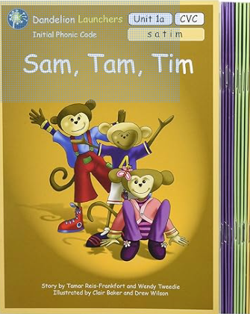
Dandelion books

Slide 27
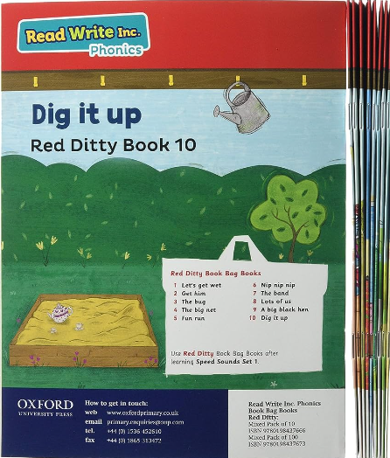
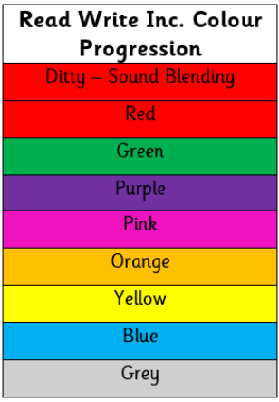
RWI book bag books

Slide 28
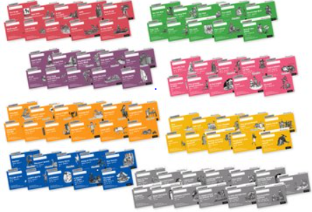
Story books

Slide 29
Any questions?
Q&A

Slide 30
Year 1 talk
We will show you a RWI video that shows a set 2 lesson in action.
We will then talk about the Phonics screening (the statutory phonics test that all Year 1 children take)

Slide 31
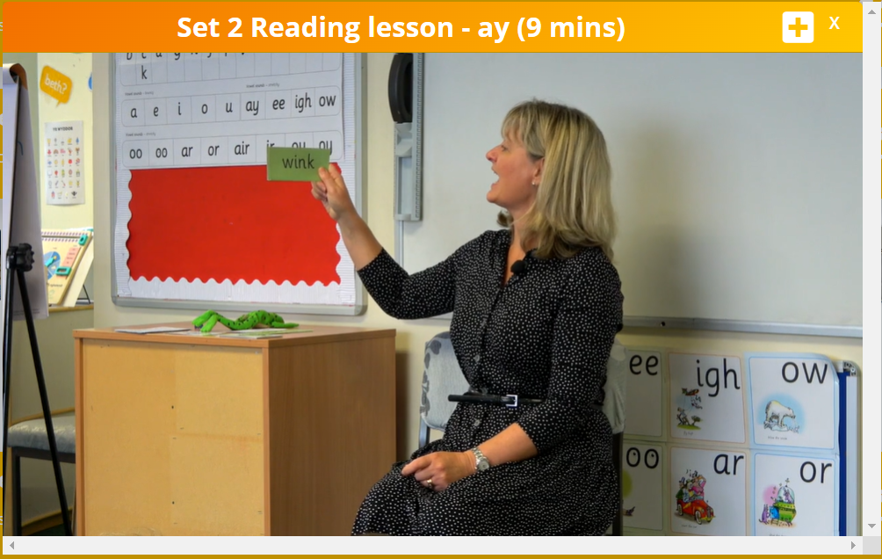
Learning to read words

Slide 32
What is the Phonics Screening Check?
A word-reading test at the end of Year 1.
Children read 40 words.
Notes:
Children complete the phonics screening check at the end of Year 1 so that parents can be confident their children are being taught to read successfully.
Children read 40 words. It takes between two and five minutes.
If they do not manage to read 32 of the words successfully, they are given extra support, and repeat the check at the end of Year 2.
It means that all children will be able to read accurately before they begin Year 3.

Slide 33

‘Special Friends’, ‘Fred Talk’
Notes:
We teach children to words using the routine ‘Special Friends’, ‘Fred Talk’, read the word’.
Children spot the ‘Special Friends’ (two letters that make one sound), Fred talk the word, and then read the whole word.
For example, ‘sh’, sh-i-p, ship.

Slide 34



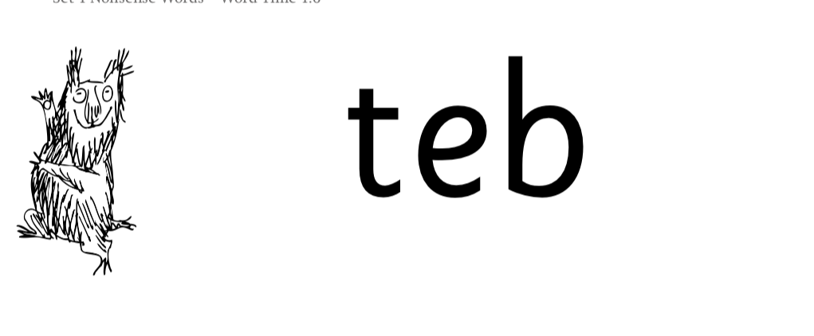
Nonsense words
Notes:
Half of the words in the check are real words.
Half are nonsense words. For example, ‘sheb’, ‘glight’, ‘ched’, ‘teb’.
There is a picture of an alien next to each word to remind the children that it isn’t a real word.
Nonsense words are used to assess children’s reading.
They check that children will be able to read sounds the sounds they know in unfamiliar words.
They read these words using the same routine as real words – ‘Special Friends, Fred Talk.’
Children who can read nonsense words will, very soon, be able to read any new word – for example – gargantuan, flailing, raucous, anticipation;
Reading new words increases children’s vocabulary rapidly.

Slide 35
Any other questions
Q&A

Slide 36
Year 2 talk
We will show you a set 3 Phonic lesson in action and then talk to you about our “Master Reader” program that will start once your child has completed RWI.

Slide 37
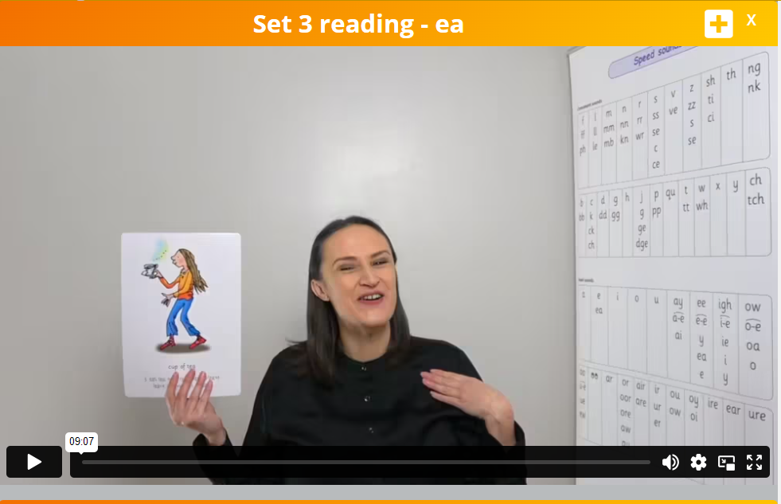
Set 3 RWI lesson

Slide 38

What happens after RWI?

Slide 39
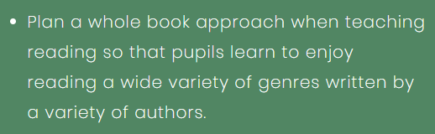
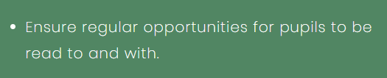
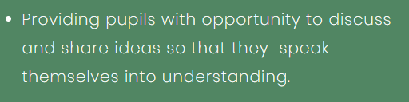
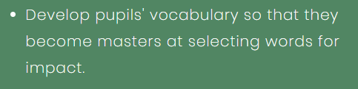
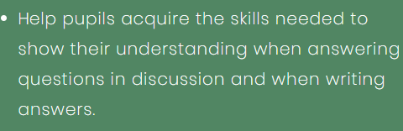
What do we do?

Slide 40
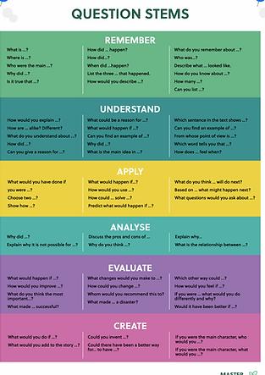
How do we use our Question Stems?

Slide 41
What does a typical week look like in A master Readers lesson?
Notes:
Talk through the slides you use to teach to explain.

