Slide 1
Willow Bank Infant School
Phonics, English and Maths
Information Evening
Thursday 18th November 2021
7pm

Slide 2
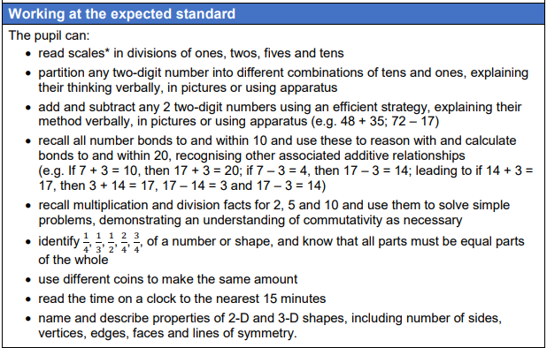
Year 2 Maths
By end of Year 2 these are the age-related expectations:

Slide 3
Year 2 Maths
Build on previous learning.
The aim is for all children to develop fluency before moving on to problem solving and reasoning.
They start using maths apparatus/equipment before developing their skills in written methods.
Children cannot use maths equipment in the SATs so they all need to develop secure pictorial and written strategies.

Slide 4


The development of mathematical strategies .
Concrete
Pictorial
Abstract
T
O
X
2
2
X

Slide 5
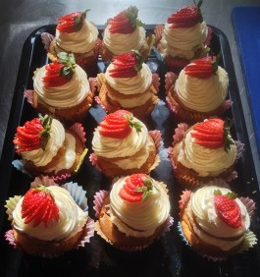
The development of mathematical strategies.
Concrete
Pictorial
Abstract
XX
XX
XX
XX
3 x 4 = 12
XX
XX

Slide 6

Year 2 Maths
SODA (Start of the Day Activity) : Each day the children complete an arithmetic question or a word problem.
What a typical lesson looks like:
Warm-up mental arithmetic e.g. counting in 10s, 5s, 2s, and 3s and number bonds to 20
Whole class input to introduce or consolidate learning
Independent work or small group work to develop fluency (adult supported where necessary)
Once fluent children directed towards problem solving and reasoning (chilli challenges)
Round- up of learning by discussing efficient strategies and identify next steps

Slide 7
Mastery
Don’t confuse fluency with mastery.
Completing 10 or more calculations is being fluent, it doesn’t mean they have mastered the concept.
Mastery means being able to solve problems and reason about their learning. For example:
    Can you explain your strategy?
    Can you draw it?
    Can you show me with coins?
    Can you find the most efficient method?

Slide 8
Practical ideas for helping at home
Counting to 100 forwards and backwards in 1s, 2s, 5s and 10s
Ensure they can form their numbers correctly
Write numbers using correct place value
Recognise coins and notes
Verbal recall of number bonds to 10, 20 and 100
http://www.primaryhomeworkhelp.co.uk/maths/index.html
https://www.topmarks.co.uk/
http://www.ictgames.com/resources.html

Slide 9
Any questions?

Slide 10

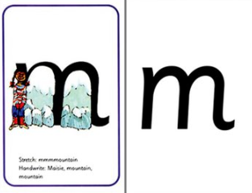
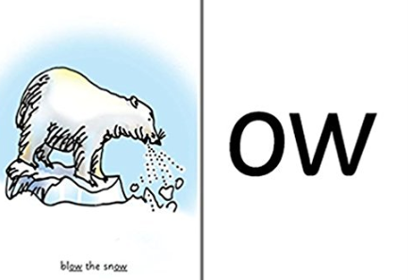
Phonics
Phonics helps children to develop reading and spelling skills at an early stage
We use Read Write Inc. as our teaching resource.

Slide 11

Phonics
Language we use:
Phoneme is what we hear – smallest unit of sound
sh o p
Digraph – 2 letters that make 1 sound - special friends
ai (rain) ee (sheet) ow (cow)
Trigraph – 3 letters that make 1 sound - special friends
igh (high) ear (hear) air (fair)
Grapheme – is what you see.
The letters that represent each sound.
Notes:
Oral blending – no text

Slide 12
Blending – a key skill for reading
Recognising the letter sounds in a written word, for example: c-u-p cup
and then merging or ‘blending’ them in the order in which they are written to pronounce the word ‘cup’.
Segmenting – a key skill for writing
‘Chopping up’ or ‘sound out’ the word to spell it out.
The opposite of blending cup chip
Identify the individual sounds in a spoken word in order to write

Slide 13
Enunciation
Teaching phonics requires a technical skill in enunciation
Phonemes should be articulated clearly and precisely.
sssssss not suh t not tuh
l not luh
F not fuh
Notes:
Most consonants should be pronounced in a continuous manner – e.g. ssssss mmmmmm llllllll nnnnnn shshshsh rrrrrrr zzzzzzzz vvvvvvv
Some can’t be said like this (e.g. /c/ /t/ /p/ /b/ /d/ and /g/) but /c/, /t/ and /p/ should be enunciated without the voice.
Phonemes wwwwww and yyyyyyyy are not easy but can be attempted.
Many errors spring from incorrect enunciation e.g. teachers reporting that children confuse ‘ch’ and ‘tr’. If the ‘ch’ is enunciated correctly, as one phoneme, rather than ‘chur’and ‘tr’ clearly as 2, there is far less likelihood of confusion.
Regional pronunciation could be a factor here. The PNS states in a position paper on teaching phonics that -
Many of the sounds (particularly vowel sounds) can vary slightly according to accent, but they are generally consistent within the speech of an individual and recognisable by others who may pronounce them slightly differently.
ACTIVITY
Take time in your group to agree the correct pronunciation of phonemes. It is important that all phases represented here have a shared and common understanding of this factor.

Slide 14


Phoneme fingers (Fred Fingers) to help with oral blending ml
a-t
We use our phoneme fingers to count out how many sounds we can hear in a word.
m-i-l-k
s-t-r-i-p-e
sh-i-p
t-r-ai-n

Slide 15
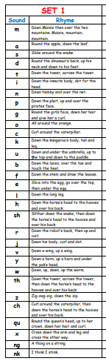
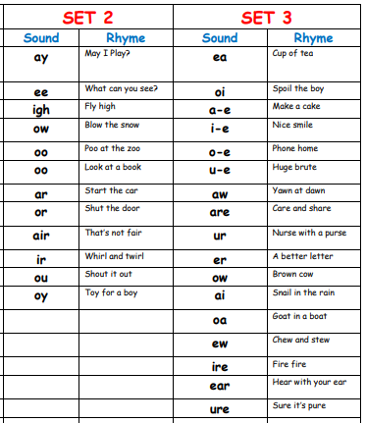
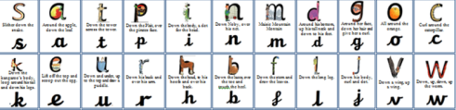
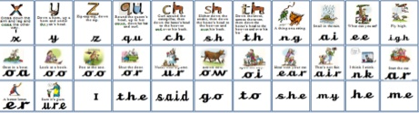

Slide 16
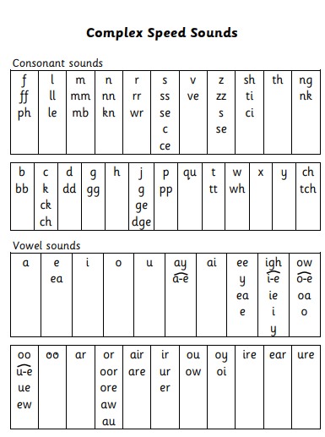

Slide 17
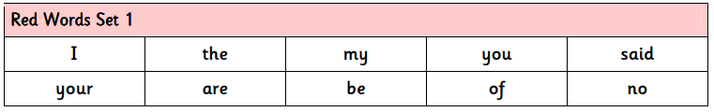
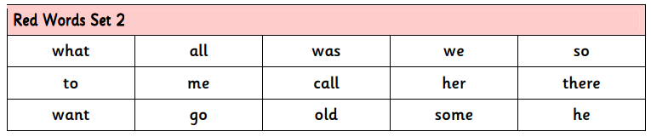
Tricky (Red) Words
The children also practise reading (and spelling) what we call ‘tricky words’, such as ‘once,’ ‘have,’ ‘said’ and ‘great’. These are words where one part of the word is trying to trick the children. We teach them to sound the word out, then look at the word and spot the part that is trying to trick us.

Slide 18
A Phonics Lesson
A typical lesson looks like this:
SAY THE SOUND Tell the story and Fred-talk the rhyme on the card
REVIEW Practise spotting the sound within other familiar sounds
READ WORDS Blend (Fred-talk) and read green words which contain new sound
REVIEW Read green words containing familiar sounds
NONSENSE WORDS Blend (Fred-talk) alien words which contain new sound
SPELLINGS Segment words (using Fred-fingers) to spell green words containing new sound

Slide 19
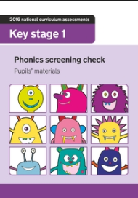
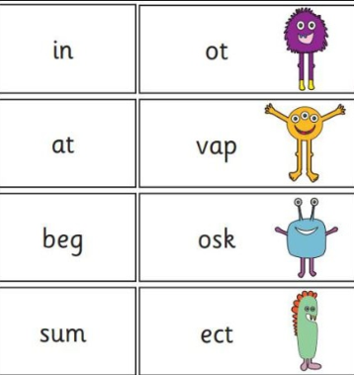
Phonics Screening Test
40 words – some real some pseudo (alien) words

Slide 20
Practical ideas for helping at home
Become familiar with the complex speed chart
Ask your child to use their Fred fingers to build words
Practise sight reading red words speedily
Think about signing up to phonics play
www.phonicsplay.co.uk

Slide 21
Any questions?

Slide 22
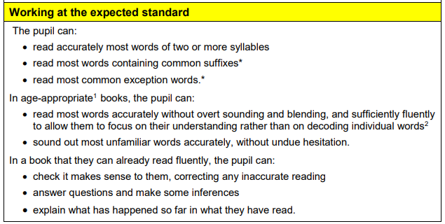
Reading
By end of Year 2 these are the age-related expectations:

Slide 23
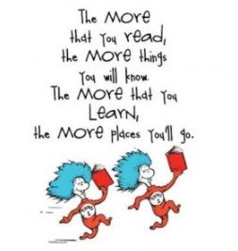




Slide 24
The Power of Reading
Reading regularly is key to helping the children develop an interest in the world around them and increasing their vocabulary.
Try to listen to your child read three times a week, you don’t need to read the whole book.
Please sign the reading diary when you read with your child.

Slide 25
1:1 Reading and reading at home
Once children have completed the Read Write Inc reading scheme, they move onto the Oxford Reading Tree reading scheme.
If your child is on the Read Write Inc reading scheme they will be assessed every half-term.
Once your child has moved to the Oxford Reading Tree scheme they are assessed using the Benchmarking assessment. This includes talking about the text and answering comprehension questions.

Slide 26
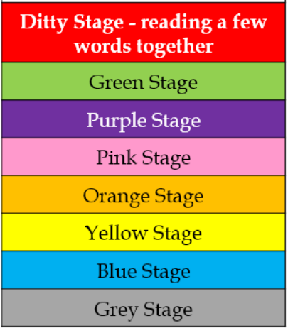

Slide 27

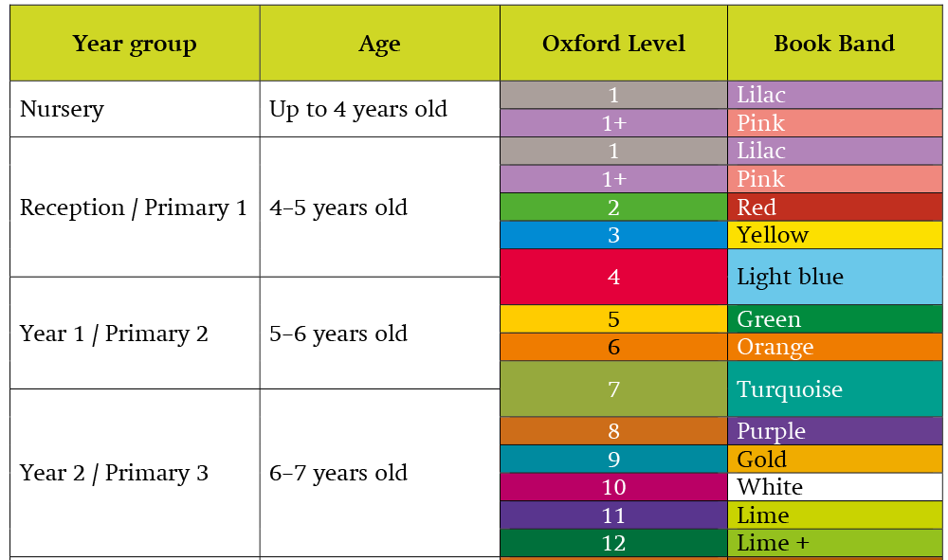

Slide 28
A Storybook Lesson
A typical lesson for day 1 looks like this:
Daily speed sound lesson
Speed sounds from the book
Speedy green words/story green words from the book
Read red words from the book
Partner practise
Story introduction
First read – children
Read aloud – teacher
Handwriting
Hold a sentence

Slide 29
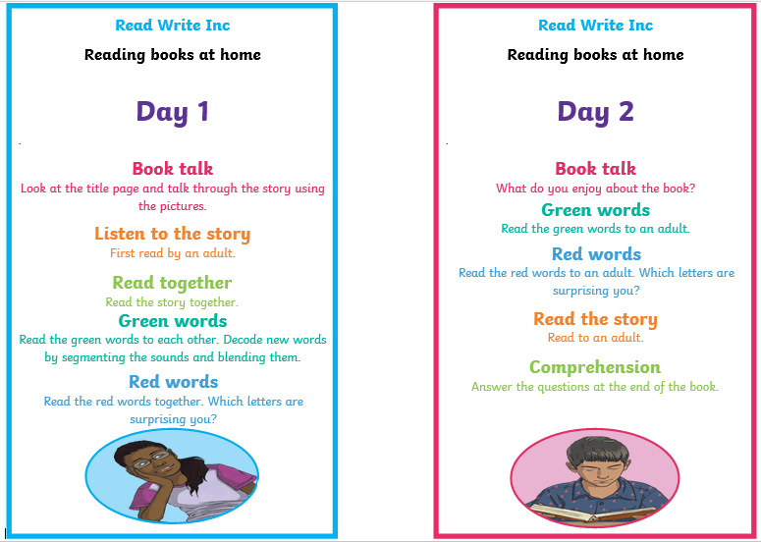
How can I help my child?

Slide 30
Any questions?

Slide 31
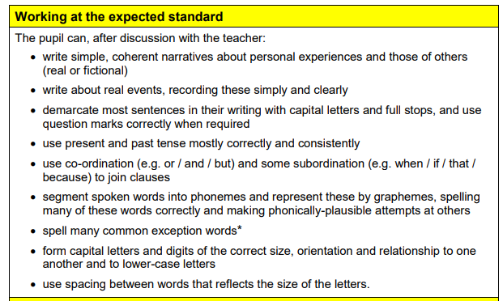
English
By end of Year 2 these are the age-related expectations:

Slide 32

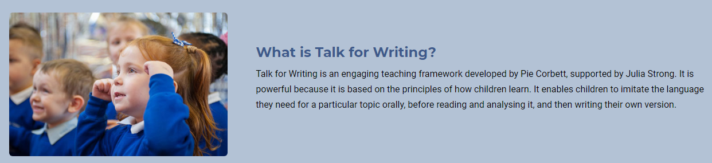
Talk for Writing

Slide 33
The Talk for Writing approach enables children to read and write independently for a variety of audiences and purposes.
A key feature is that children internalise the language structures needed to write through ‘talking the text.’
The approach moves from dependence towards independence, with the teacher using shared and guided teaching to develop the ability in children to write creatively and powerfully.

Slide 34

The key phases of the Talk for Writing process, as outlined above, enable children to imitate orally the language they need for a particular topic, before reading and analysing it, and then writing their own version.

Slide 35
An English Lesson
A typical TfW English lesson for looks like this:
Jumpstart activity
Read the speed-words
Listen to the story
Practise the actions to the story’s script
Develop a writer’s toolkit
Re-tell the story

Slide 36
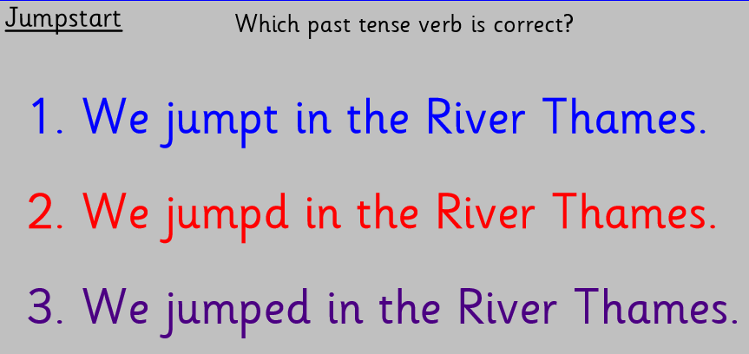
An example of a Jumpstart

Slide 37
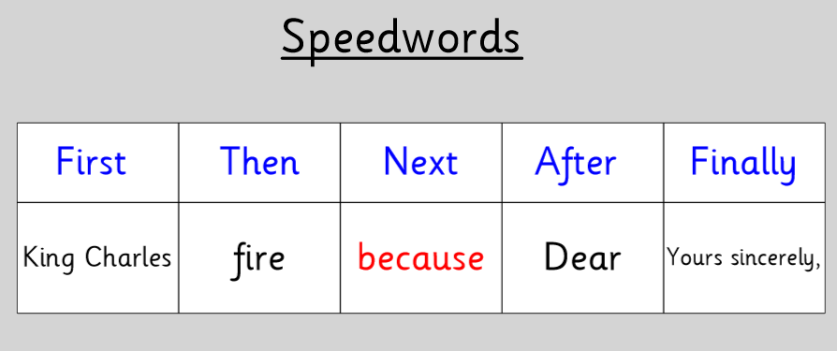
An example of Speedwords

Slide 38
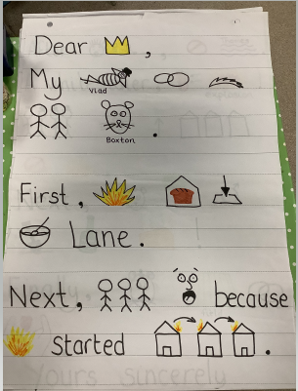
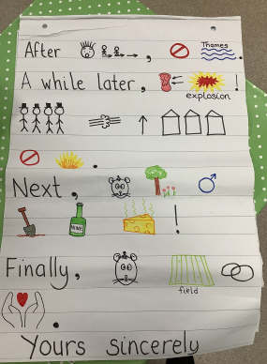
An example of a TfW storyboard/script

Slide 39
Not all our writing units follow the TfW structure but many features are applied when writing non-fiction texts or when writing poetry.

Slide 40
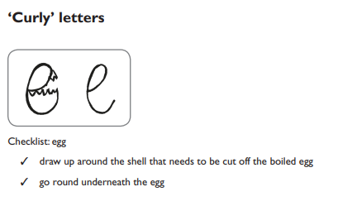
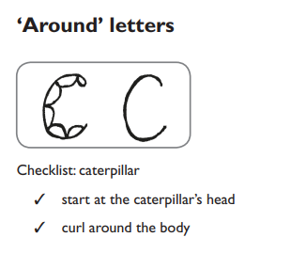
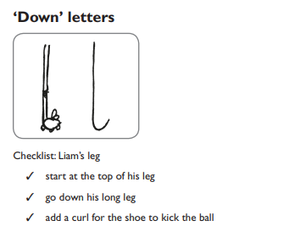
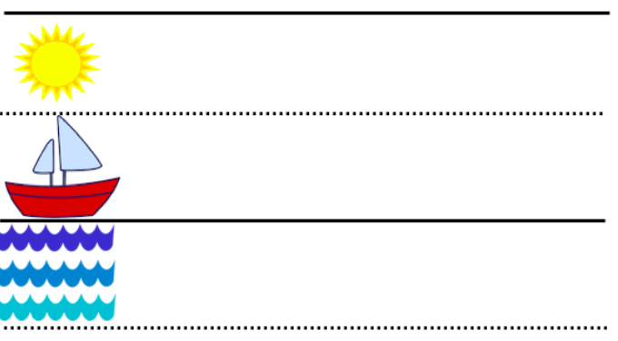
Handwriting patterns

Slide 41
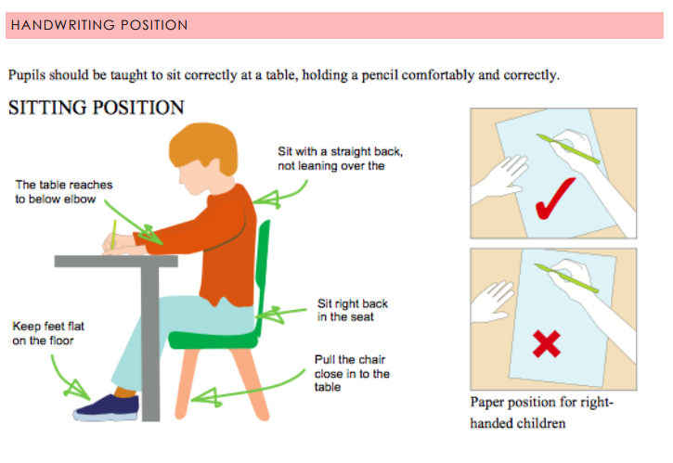

Slide 42
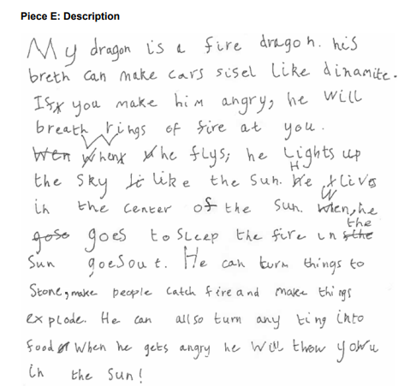
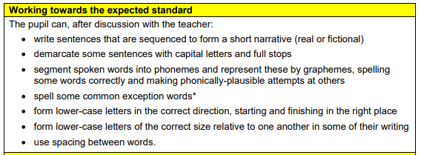
Working towards the expected standard

Slide 43
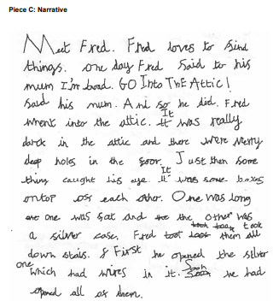
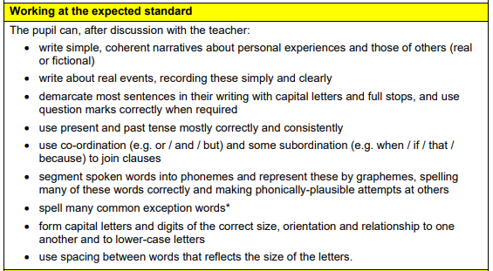
Working at the expected standard

Slide 44
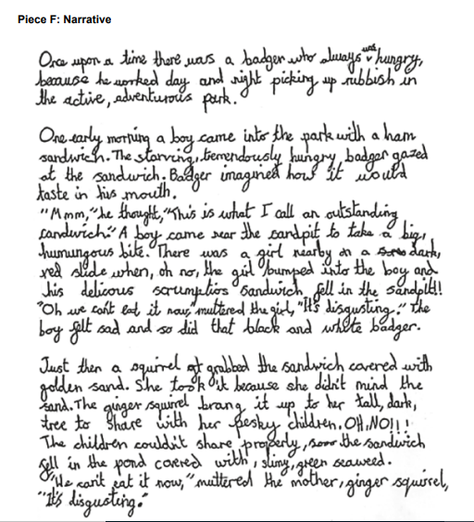
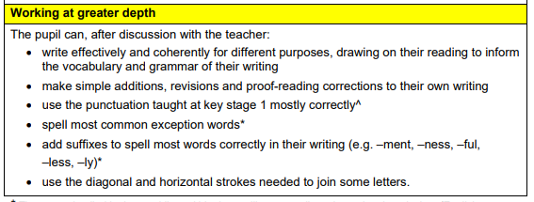
Working at greater depth within the expected standard

Slide 45
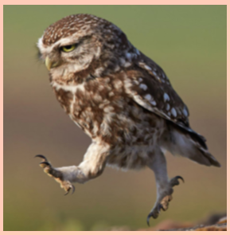


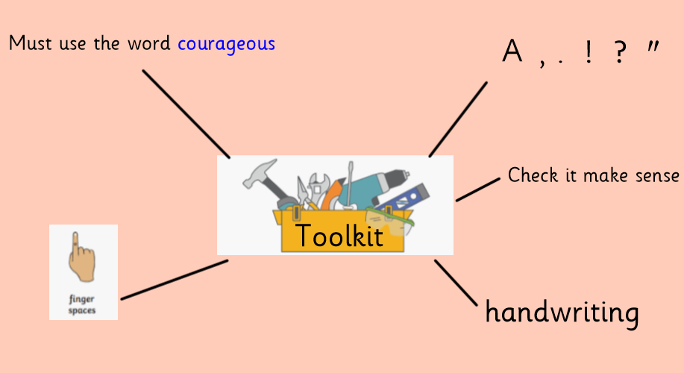
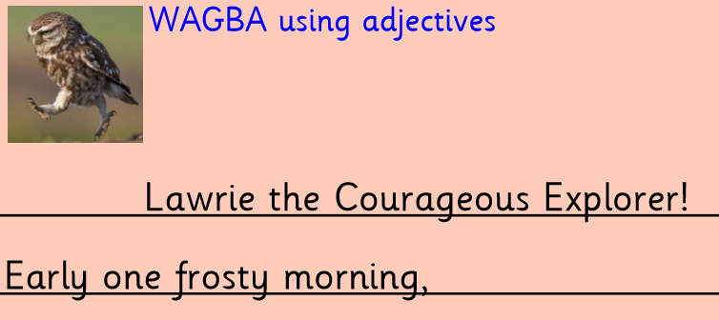

Slide 46
How can I help my child at home?
Spelling red words from memory
Encourage your child to write sentences at home using finger spaces, full stops and capital letters.
Practise handwriting- correct letter formation, size of letters need to be consistent.

Slide 47
Any questions?

